Slide 1
Pleading Change
Unraveling the Impact of Bail Reform on Guilty Pleas in Harris County
Jamie Pantazi Esmond

Slide 2
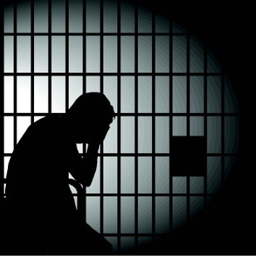
Background
Cash bail – money given to a court to allow an individual charged with a crime to leave jail and return later for trial
Pretrial detention – if bail is denied or cannot be paid, the individual must await trial in jail

Slide 3
Background
Cash bail – money given to a court to allow an individual charged with a crime to leave jail and return later for trial
Pretrial detention – if bail is denied or cannot be paid, the individual must await trial in jail
14th Amendment – “No State shall…deprive any person of life, liberty, or property, without due process of law”
Several states and counties have eliminated cash bail for some or all charges including Harris County, TX

Slide 4
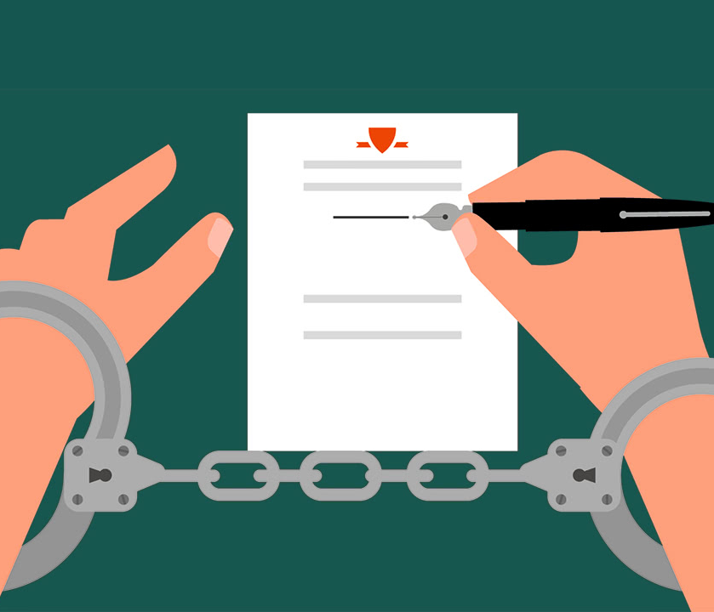
Bail Set
Take Guilty Plea Deal
Pay Bail
Go Home
Go Home
Stay in Jail
Lose Job/Kids/Home

Slide 5
Hypothesis
Bail Set
Take Guilty Plea Deal
Pay Bail
Go Home
Go Home
Stay in Jail
Lose Job/Kids/Home
The elimination of cash bail for misdemeanor offenses is expected to lead to a reduction in the number of guilty plea deals accepted and potentially reduce any disparity among racial groups.

Slide 6

Cost-Benefit Analysis
Benefits
Supports employment stability
Eliminate lost income, childcare, and tax loss
Reduced welfare for families
Reduced trauma and PTSD from detention
Reduced assault in detention
Reduced strain on relationships (which is likely to imply reduced domestic violence)
Economic - $130+ million / year
Healthcare - $70+ million / year
Social - $77+ million / year

Slide 7
Cost-Benefit Analysis
Benefits
Savings
Supports employment stability
Eliminate lost income, childcare, and tax loss
Reduced welfare for families
Reduced trauma and PTSD from detention
Reduced assault in detention
Reduced strain on relationships (which is likely to imply reduced domestic violence)
Economic - $130+ million / year
Healthcare - $70+ million / year
Social - $77+ million / year
Detention savings
$83/day per person = $67,139,720/year

Slide 8
Cost-Benefit Analysis
Benefits
Savings
Supports employment stability
Eliminate lost income, childcare, and tax loss
Reduced welfare for families
Reduced trauma and PTSD from detention
Reduced assault in detention
Reduced strain on relationships (which is likely to imply reduced domestic violence)
Economic - $130+ million / year
Healthcare - $70+ million / year
Social - $77+ million / year
Detention savings
$83/day per person = $67,139,720/year
Costs
Independent monitors
Median Salary for Harris County employees x 5 monitors = $321,390/year
Education and training
Guestimate = $39,000 one time
Website design/maintenance
$15,000 one time + $2,000/year

Slide 9
Discounted Benefit-Cost Ratio
Bail Reform
4.1
No Bail Reform
0.0002
Notes:
Save $1,314,246,575 over 5 years or spend $328,742,617?
Save over a billion or spend close to half a million??

Slide 10
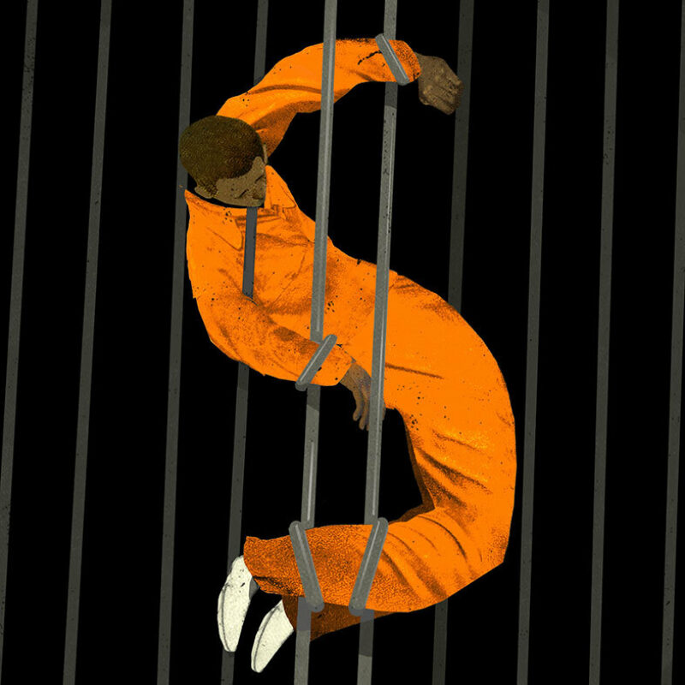
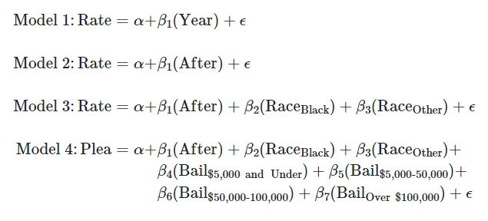
Impact Analysis

Slide 11
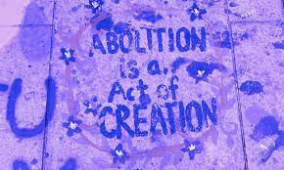
Data
Harris County court records for all arrests 2015 - 2022
Filtered for only misdemeanor arrests
Cleaned and aggregated by month and year
Each month labeled before or after implementation

Slide 12
Data
Harris County court records for all arrests 2015 - 2022
Filtered for only misdemeanor arrests
Cleaned and aggregated by month and year
Each month labeled before or after implementation
Unit of analysis: one month of arrests
Outcome variable: rate of guilty pleas

Slide 13
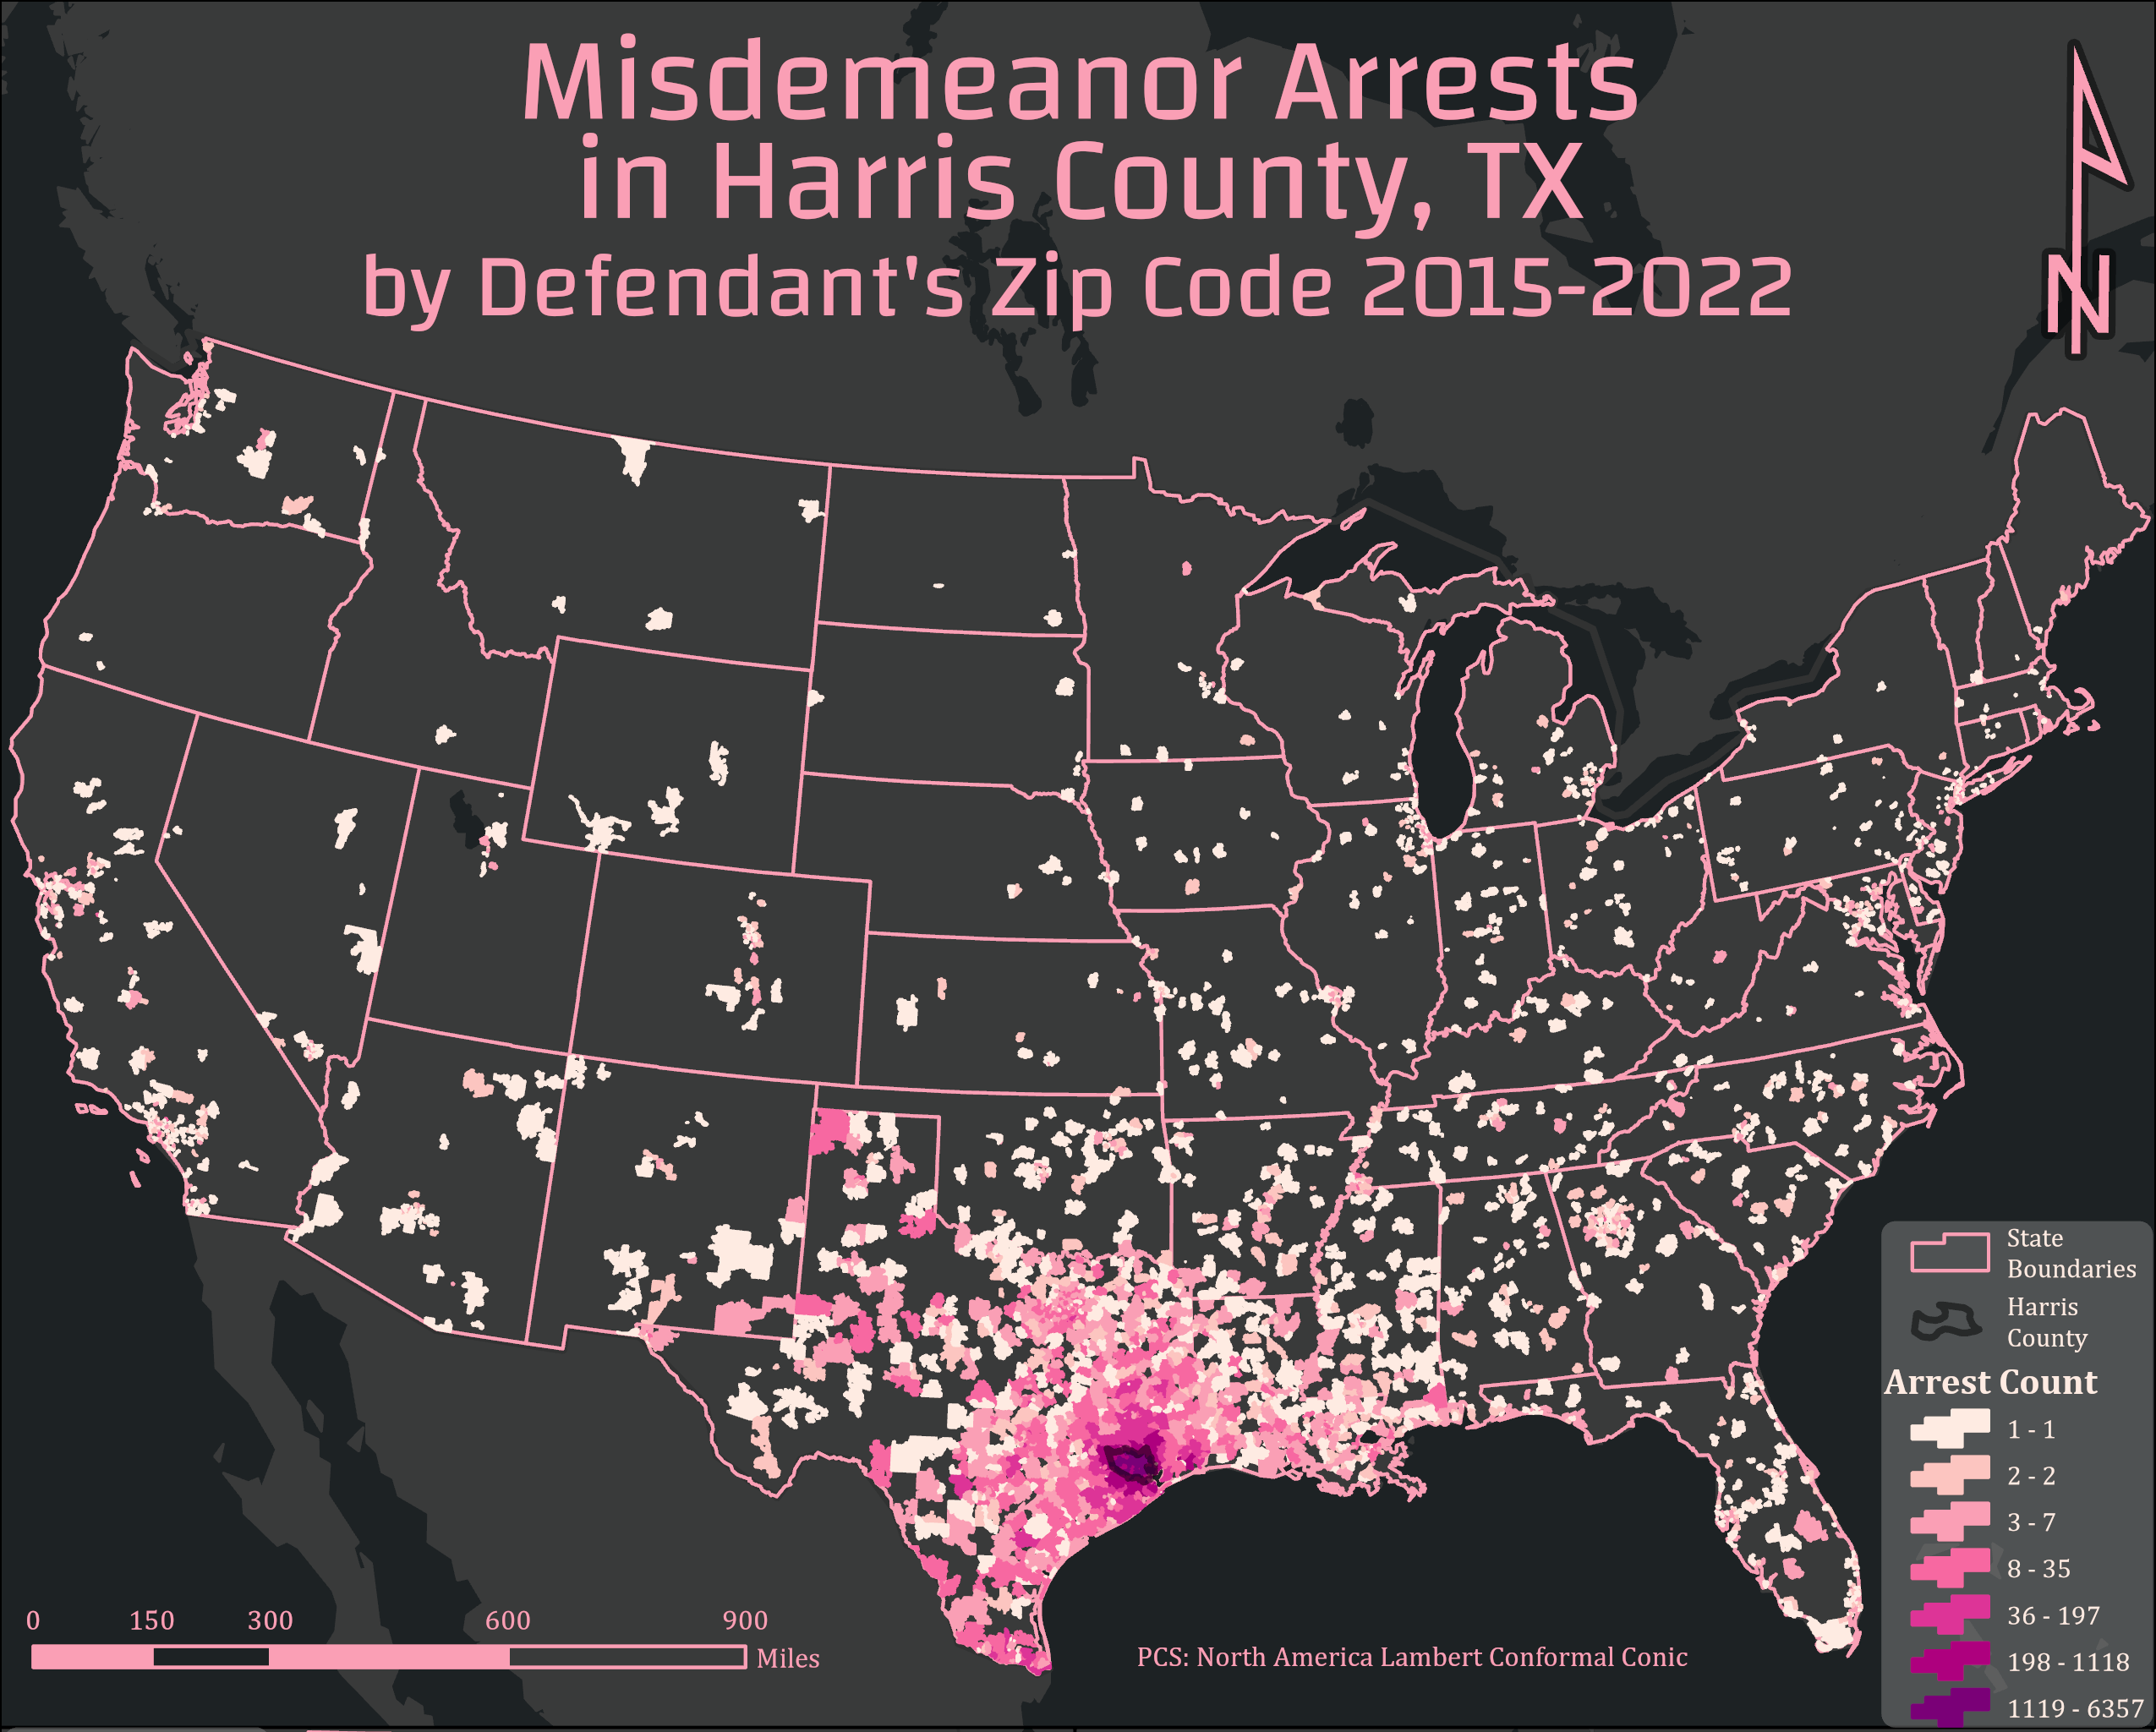
Chart
Scope
Misdemeanor arrests impact people from every state in the US
not just a Houston issue

Slide 14
Chart
Scope
Misdemeanor arrests impact people from every state in the US
Arrest and detention in a place far from home levies an even heavier financial burden
not just a Houston issue
disrupted travel plans
less local support

Slide 15
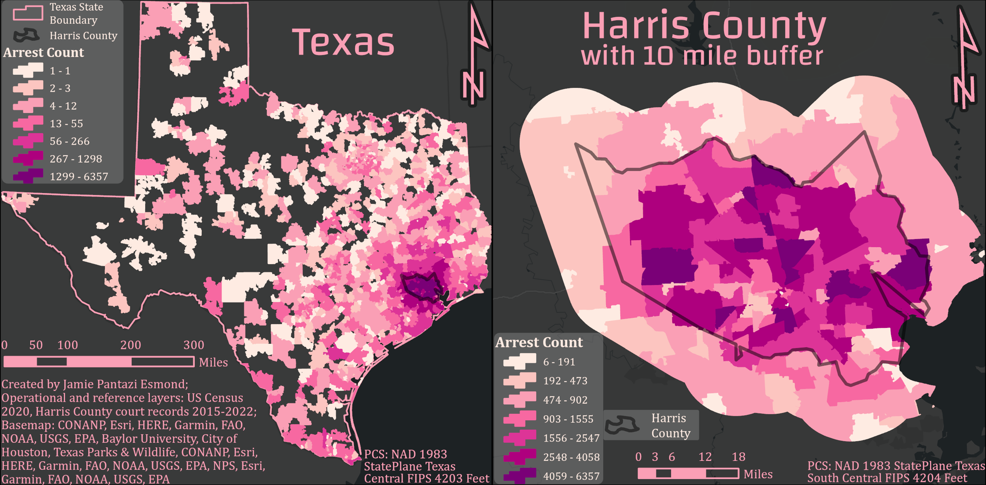
Zooming in…

Slide 16
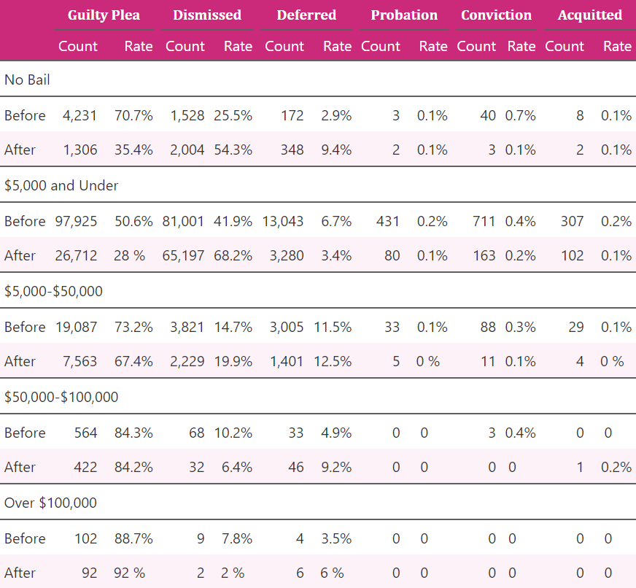
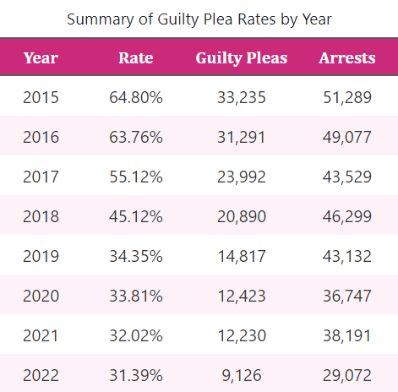
Summary of Case Outcomes
Notes:
Scary numbers

Slide 17
Summary of Case Outcomes
The vast majority of misdemeanor arrests had a bail amount below $50,000 (96.7%)
The rate of guilty pleas fell for every bail category below $50,000 after implementation
The total number of arrests each year also fell after implementation
85.7% below $5,000

Slide 18
Summary of Case Outcomes
The vast majority of misdemeanor arrests had a bail amount below $50,000 (96.7%)
The rate of guilty pleas fell for every bail category below $50,000 after implementation
The total number of arrests each year also fell after implementation
85.7% below $5,000

Slide 19
Summary of Case Outcomes
Notes:
The total number of arrests each year also fell after implementation

Slide 20
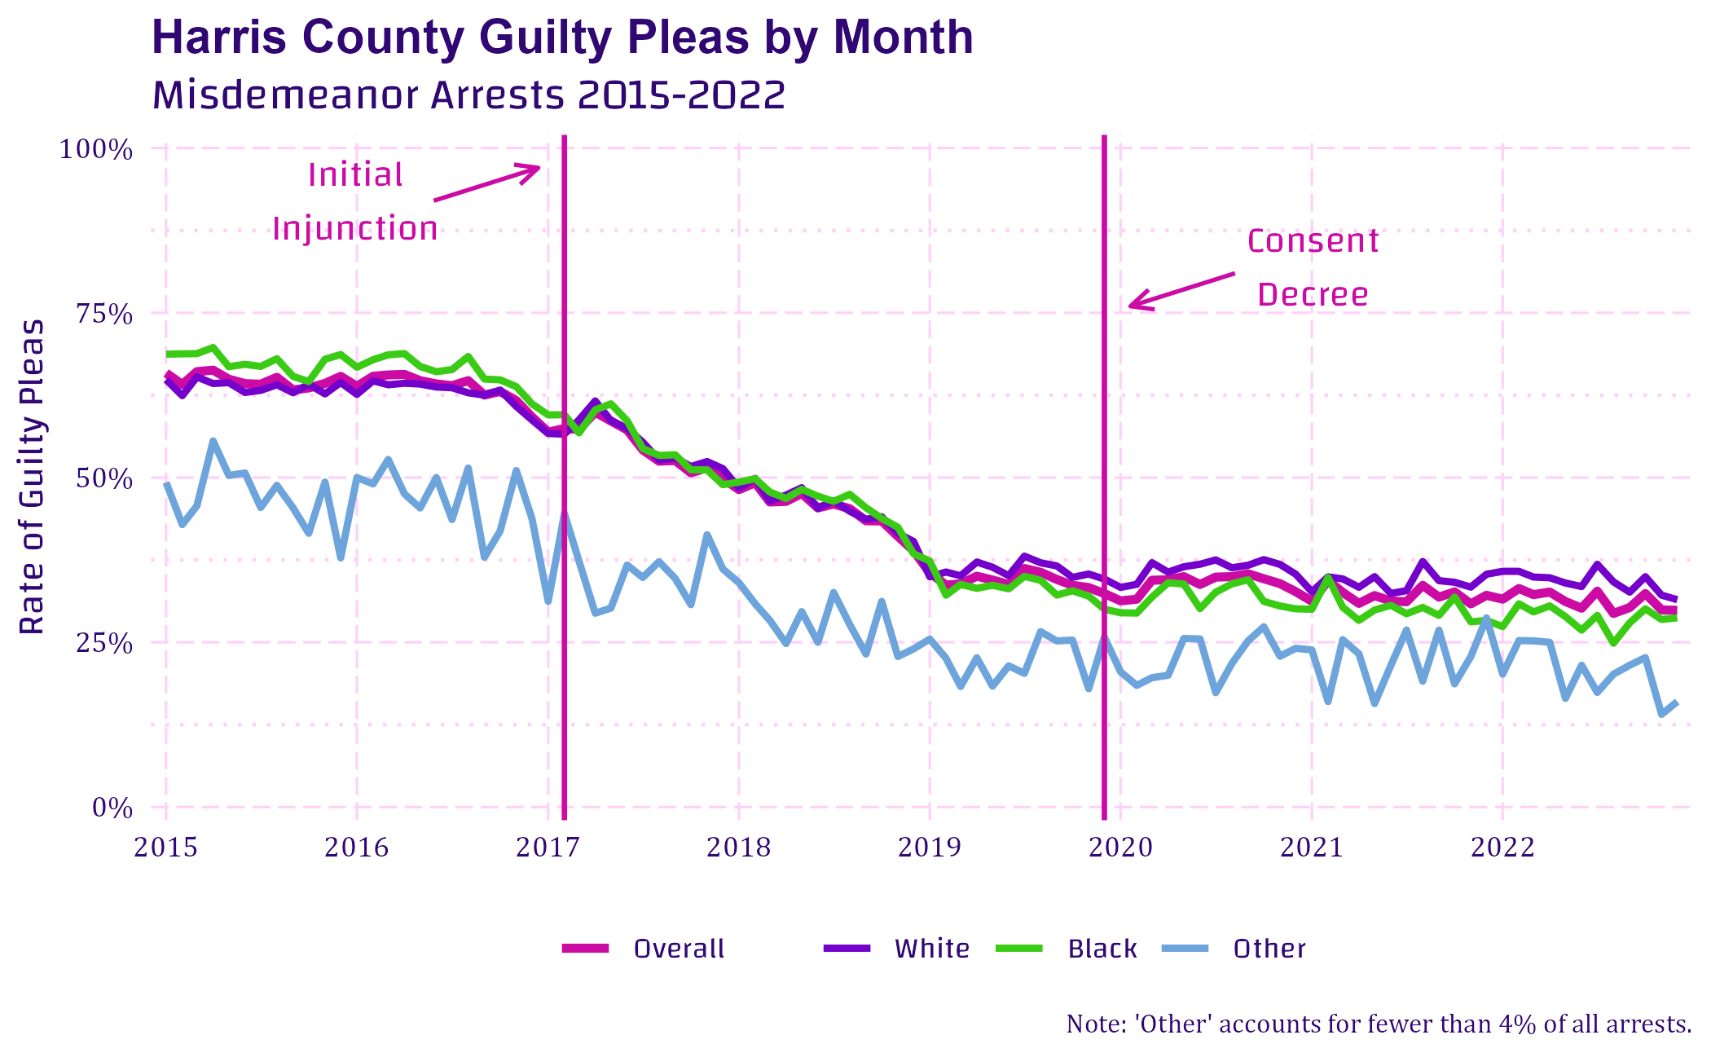
Trends

Slide 21
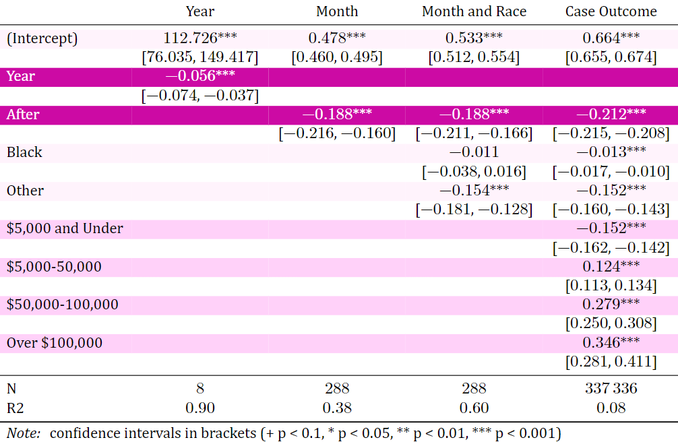
Regression
Notes:
Scarier numbers

Slide 22
Regression
Estimated 5.6 percentage point drop each year

Slide 23
Regression
Estimated 18.8 percentage point drop after implementation

Slide 24
Regression
Estimated 18.8 percentage point drop after implementation
But no meaningful difference between races

Slide 25
Regression
The higher the bail amount the higher the probability of accepting a guilty plea
Notes:
Probability not rate

Slide 26
Discussion
Assumptions & Shortcomings
Sample size does the heavy lifting
Potential unobserved variable(s)
Missing Hispanic variable

Slide 27
Discussion
Assumptions & Shortcomings
Sample size does the heavy lifting
Potential unobserved variable(s)
Missing Hispanic variable
337,336 arrests analyzed from 2015-2022

Slide 28
Discussion
Assumptions & Shortcomings
Sample size does the heavy lifting
Potential unobserved variable(s)
Missing Hispanic variable
337,336 arrests analyzed from 2015-2022
External events, unobservable characteristics, qualitative measures

Slide 29
Discussion
Assumptions & Shortcomings
Sample size does the heavy lifting
Potential unobserved variable(s)
Missing Hispanic variable
337,336 arrests analyzed from 2015-2022
External events, unobservable characteristics, qualitative measures
Only race was recorded, not ethnicity
Notes:
Approximately 43% of Harris County identifies as Hispanic according to the 2021 American Community Survey.

Slide 30
Discussion
Assumptions & Shortcomings
Sample size does the heavy lifting
Potential unobserved variable(s)
Missing Hispanic variable
Descriptive only
Not generalizable
No counterfactual

Slide 31
Alternatives
Pretrial detention (status quo)
Electronic Monitoring
Eliminating All Cash Bail

Slide 32
Alternatives
Pretrial detention (status quo)
Electronic Monitoring
Eliminating All Cash Bail
Cons
More expensive
Disproportionately impacts communities of color
Disrupts employment, family, and housing opportunities
Pros
Illusion of public safety through detention and determent
Bail Bondsmen stay in business

Slide 33
Alternatives
Pretrial detention (status quo)
Electronic Monitoring
Eliminating All Cash Bail
Cons
More expensive
Disproportionately impacts communities of color
Disrupts employment, family, and housing opportunities
Pros
Illusion of public safety through detention and determent
Bail Bondsmen stay in business
Cons
Still more expensive than release
Technological issues can have catastrophic consequences
Stigma can alienate people from their community and support structures
Pros
Illusion of public safety by expanding the carceral system
Less costly than detention
Politically appealing

Slide 34
Alternatives
Pretrial detention (status quo)
Electronic Monitoring
Eliminating All Cash Bail
Cons
More expensive
Disproportionately impacts communities of color
Disrupts employment, family, and housing opportunities
Pros
Illusion of public safety through detention and determent
Bail bondsmen stay in business
Cons
Still more expensive than release
Technological issues can have catastrophic consequences
Stigma can alienate people from their community and support structures
Pros
Illusion of public safety by expanding the carceral system
Less costly than detention
Politically appealing
Cons
Politically improbable
Pros
Puts release eligibility in the hands of the judge instead of the bank account of the defendant
Frees up resources to alleviate factors that contribute to criminal activity

Slide 35

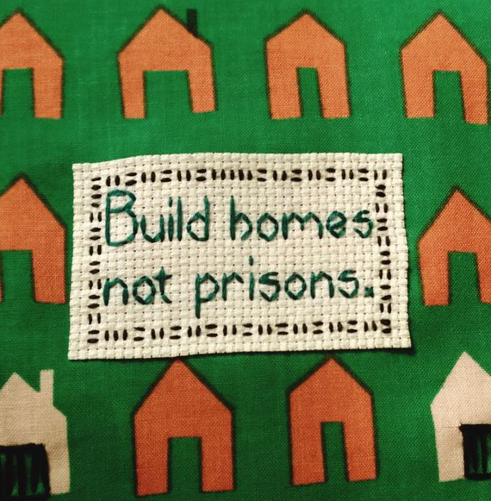

Conclusion
Potentially responsible for a significant reduction in guilty pleas

Slide 36
Conclusion
Potentially responsible for a significant reduction in guilty pleas
Exceedingly cost-effective - already saved Harris County millions

Slide 37
Conclusion
Potentially responsible for a significant reduction in guilty pleas
May reduce recidivism and future crime by keeping people in their homes and jobs
Exceedingly cost-effective - already saved Harris County millions

Slide 38
References
Akee, R., Jones, M. R., & Porter, S. R. (2019). Race Matters: Income Shares, Income Inequality, and Income Mobility for All U.S. Races. Demography, 56(3), 999–1021.
Arnold Ventures. (2022, August 30). New Data Shows Harris County Misdemeanor Bail Reform Has Positive Impact On Public Safety. Arnold Ventures.
Baughman, S. B. (2017). Costs of Pretrial Detention. Boston University Law Review, 97(1), 1–30.
Berry, D., & English, P. (2011). The Socioeconomic Impact of Pretrial Detention: A Global Campaign for Pretrial Justice Report. Open Society Justice Initiative.
Carney, L. (2016, October 31). How Much Does a Website Cost in 2023? (Complete Guide). Website Builder Expert.
Covert, B. (2022, July 19). Bail Reform Helps Countless People. Why Don’t We Hear More of Their Stories? The Appeal.
DeAngelis, T. (2023). By the numbers: Examining the staggering cost of PTSD. American Psychological Association, 54(1), 104.
Digard, L., & Swavola, E. (2019). Justice Denied: The Harmful and Lasting Effects of Pretrial Detention.
Dobbie, W., Goldin, J., & Yang, C. S. (2018). The Effects of Pre-Trial Detention on Conviction, Future Crime, and Employment: Evidence from Randomly Assigned Judges. American Economic Review, 108(2), 201–240.
Eason, J. M., Zucker, D., & Wildeman, C. (2017). Mass Imprisonment across the Rural-Urban Interface. The ANNALS of the American Academy of Political and Social Science, 672(1), 202–216.
Fajnzylber, P., Lederman, D., & Loayza, N. (2002). Inequality and Violent Crime. The Journal of Law and Economics, 45(1), 1–39.
Fleisher, B. M. (1966). The Effect of Income on Delinquency. The American Economic Review, 56(1/2), 118–137. JSTOR.
Freeman, R. B. (1999). The Economics of Crime. In Handbook of Labor Economics (Vol. 3, pp. 3529–3571). Elsevier.
Gilmore, R. W. (2007). Golden Gulag: Prisons, Surplus, Crisis, and Opposition in Globalizing California (1st ed.). University of California Press.
Gius, M. (2018). The Determinants of Pretrial Detention and Its Effect on Conviction and Sentencing Outcomes. Justice Policy Journal, 16(2).
Gupta, A., Hansman, C., & Frenchman, E. (2016). The Heavy Costs of High Bail: Evidence from Judge Randomization. The Journal of Legal Studies.
Harris County. (2023a). Harris County Criminal Court Data Dashboard [CSV].
Harris County. (2023b). Jail Pop History—Jail Population. Harris County Texas.
Harris County Salaries—Texas. (2022).
Heaton, P. (2022). The Effects of Misdemeanor Bail Reform. Quattrone Center for the Fair Administration of Justice.
Heaton, P., Mayson, S. G., & Stevenson, M. (2017). The Downstream Consequences of Misdemeanor Pretrial Detention. Stanford Law Review, 69, 711–794.
Imran, M., Hosen, M., & Chowdhury, M. A. F. (2018). Does poverty lead to crime? Evidence from the United States of America. International Journal of Social Economics, 45(10), 1424–1438.
Intrator, J., Tannen, J., & Massey, D. S. (2016). Segregation by race and income in the United States 1970–2010. Social Science Research, 60, 45–60.
Liu, B., Wei, Y. D., & Simon, C. A. (2017). Social Capital, Race, and Income Inequality in the United States. Sustainability, 9(2),
Lowenkamp, C. (2022). The Hidden Costs of Pretrial Detention Revisited. Arnold Ventures.
O’Donnell v. Harris County, 4:16-cv-01414 (U.S. District Court for the Southern District of Texas November 21, 2019).
Pettit, B., & Western, B. (2004). Mass Imprisonment and the Life Course: Race and Class Inequality in U.S. Incarceration. American Sociological Review, 69(2), 151–169.
Preston, A., & Eisenberg, R. (2022a, June 23). Don’t Blame Bail Reform for Gun Violence. Center for American Progress.
Preston, A., & Eisenberg, R. (2022b, September 19). Cash Bail Reform Is Not a Threat to Public Safety. Center for American Progress
Quandt, K. R., & Jones, A. (2021). Research Roundup: Incarceration can cause lasting damage to mental health. Prison Policy Initiative.
Sawyer, P. P., & Wagner, P. (2023). Mass Incarceration: The Whole Pie 2023. Prison Policy Initiative.
Sharkey, P. (2013). Stuck in Place: Urban Neighborhoods and the End of Progress Toward Racial Equality. University of Chicago Press.
Simes, J. T. (2021). Punishing Places: The Geography of Mass Imprisonment. Univ of California Press.
Subramanian, R., Digard, L., Washington II, M., & Sorage, S. (2020). In the Shadows: A Review of the Research on Plea Bargaining. Vera Institute of Justice.
US Census Bureau. (2020). American Community Survey 5-Year Data (2009-2021) [dataset].
Widra, E. (2022). What does successful bail reform look like? To start, look to Harris County, Texas. Prison Policy Initiative.

Slide 39
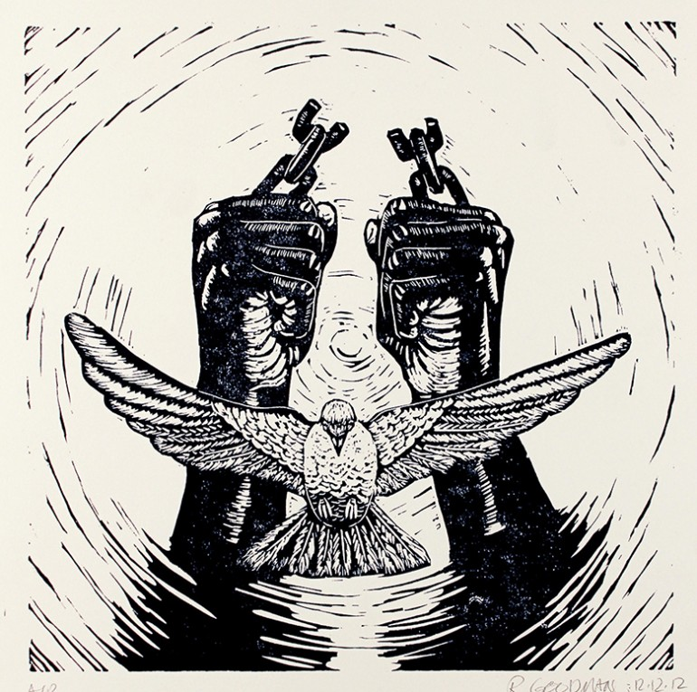
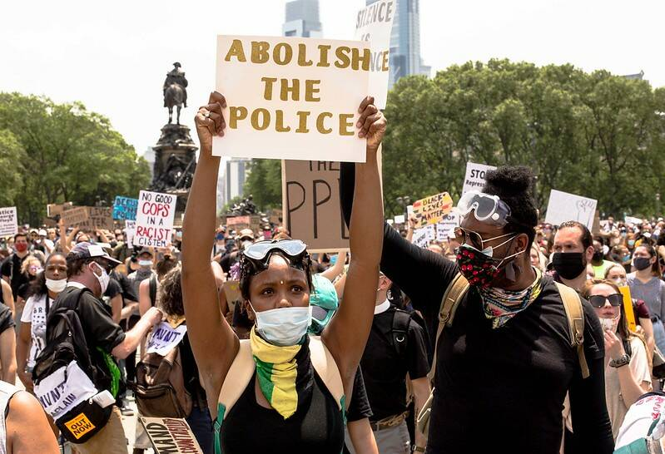
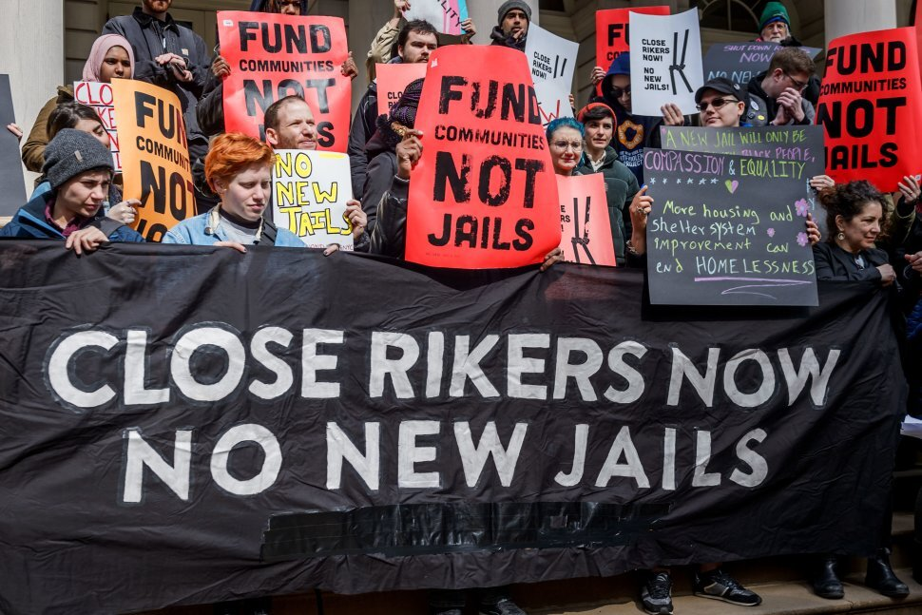

Thank you
Jamie Pantazi Esmond
We made it!

